Slide 1

May 11, 2026
2026 Municipal Budget

Slide 2

Budget / Mission Statement
Fiscal Responsibility (significant inflation impacts 2022-2026)
Maintain and Improve Quality of Life in every neighborhood
Provision of services (No reduction in services to the community)
Public Safety, Health & Welfare as priorities
Maintaining a stable tax base and tax rate
Providing services to 6000+ senior citizen residents
Remain prepared for disaster response and recovery
Debt for growth of community and distribution of costs to those who receive the benefit
Sustainable budgeting
Maintenance of strong financial ratings from Moody’s and Standard & Poor’s

Slide 3
Budget Process & Timeline
1
2
3
4
Long Term Capital
Investment Plan
6 Year Capital Plan formulation
Annual Update with input from Department Heads and other professionals
Department
Budgets
Department heads submit proposals for review by December
Annual close in January to prepare Annual Financial Statement and draft 2026 budget
Internal Financial
Review
Insertion of grant and aid programs
Adjust budgets based upon governing body goals regarding services and tax rate.
Township Committee Review
Budget Introduction
Budget Hearing / Adoption

Slide 4





Budget Goals
Manage Tax Impact:
The budget is structured to minimize increases to the municipal tax levy while maintaining financial stability and essential services.
Enhance Revenue Streams:
Identify and pursue new revenue opportunities while optimizing existing sources to reduce reliance on taxes.
Maintain Services:
The budget supports the continuation of core municipal services without reductions, ensuring consistent service delivery to residents.
Maintain Staffing Levels:
Staffing levels are maintained to ensure departments can continue to operate effectively and meet service demands.
Conserve Surplus:
Re-generate surplus utilized in budget and increase the overall municipal surplus by 15% of the budget to prevent future tax rate spikes and maintain municipal tax levy stability.

Slide 5



Budget Challenges
Healthcare Costs:
Insurance costs have increased by approximately $3 million (35%), significantly reducing budget flexibility. Health benefits have risen $4.2 million over the past 3 years.
Contractual Salary Obligations:
Existing labor agreements require approximately $1.5 million in salary increases to support ongoing staffing and service levels.
Inflationary pressures:
Ongoing inflation continues to drive up the cost of goods and services, with notable increases in fuel and energy significantly impacting day-to-day municipal operations.
Aging Infrastructure & Capital:
Capital needs such as roads, public buildings, and equipment require ongoing investment, often creating funding pressures as maintenance costs increase over time.
State Aid Loss:
Although outside municipal control, reductions in school State aid must be considered due to their impact on overall property taxes

Slide 6
TAXATION Goals & Challenges
The school district has lost more than $23M in state aid. This has led to a tax increase of over $35M since the enactment of the new State Aid funding legislation.
The Township has maintained a stable tax rate (a decrease of 6.7% last year and 3.9% this year).
The Township cannot control the School nor County tax impacts, which together make-up 68% of the total tax.
The Township’s budget is impacted by the school and county taxes as we must increase the Reserve for Uncollected based upon their increases.

Slide 7
Municipal Taxes & Assessments
 | 2025 | 2026
Total Taxable Assessed Value | $7,087,527,349.00 | $7,532,158,900.00
Municipal Levy | $34,350,000.00 | $35,100,000.00
Municipal Tax Rate | 0.485 | 0.466
% Change | -6.73% | -3.92%
Value of Average Home | $614,062.00 | $638,840.00
Taxes Paid by Average Homeowner | $2,976.08 | $2,977.01
$ Change | $61.66 | $0.93
% Change | 2.11% | 0.03%
Change per $100 of value | ($0.04) | ($0.02)
Change per $100,000 of value | ($35.00) | ($18.65)

Slide 8
TREND BY TAXING DISTRICT

Slide 9
TREND BY TAXING DISTRICT

Slide 10
Board of education impacts

Slide 12

2026 Estimated Tax apportionment

Slide 13
2026 Capital Plan
Well-managed debt service provides for capital flexibility and enables the continuous funding of necessary infrastructure improvements.
Planned Capital Projects:
Road paving
Drainage improvements
Recreation/Park improvements
Public Safety improvements & equipment
Technology enhancements
Improvements to lakes
Environmentally friendly flood reduction projects

Slide 14
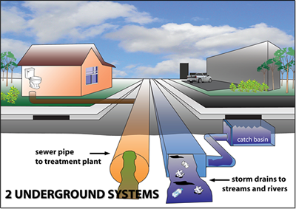
Sewer utility (sanitary)
Sewer utility is self-liquidating and regenerating surplus.
Sewer infrastructure projects will continue in efforts to reduce Infiltration & Inflow and prevent pollution of waterways.
Sewer treatment costs remain stable due to reduced flow, benefiting Neptune and the Sewer Authority
Maintaining strong surplus position to prepare for long term infrastructure improvements.

Slide 15
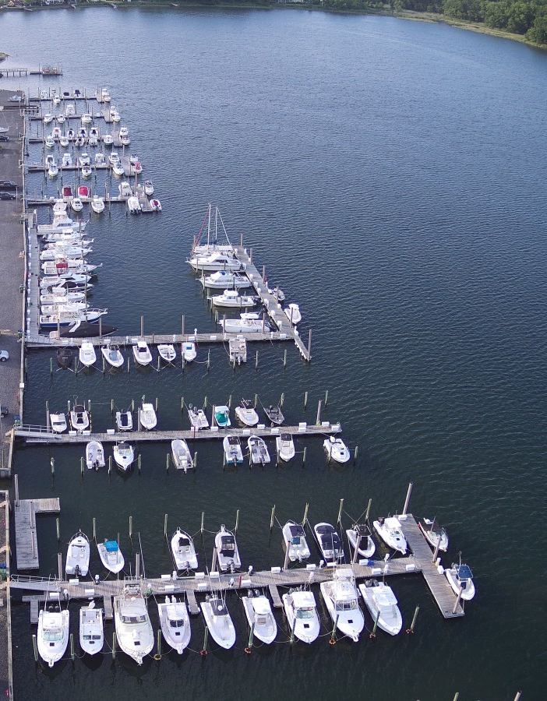
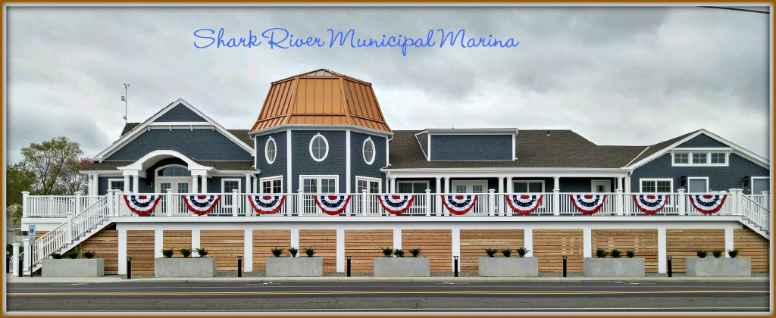
marina utility
Marina utility is self-liquidating and regenerating surplus.
Marina rates remain stable due to increased revenue from dockage, winter storage, and kayak storage (marina user fees).
Additional revenue is expected from increased storage capacity and sold-out dock space.

Slide 16
2026 Budget Summary
Projected revenues and controlled spending will maintain healthy surplus levels that assures the Township remains prepared for emergencies and economic downturns without any large tax spikes.
Continued redevelopment is expected to grow the tax base, allowing for tax rate stability.
While 2026 remains financially challenging, the Township is well positioned to continue key projects and community initiatives while maintaining strong fiscal stability.

Slide 17
Public Comment & Questions
Nicole Schnurr, CMFO
nschnurr@neptunetownship.org

