Slide 1
April 29, 2024
2024 Municipal Budget

Slide 2
Neptune Township Municipal Budget Team
Michael J. Bascom – Chief Financial Officer
Debbie Latshaw - Assistant Chief Financial Officer
Melissa Zucconi - Purchasing Agent
Gina LaPlaca - Township Administrator
Stephanie Oppegaard - Director of Human Resources
Courtney Langer – Departmental Secretary
Lisa Mansfield – Administrative Assistant to the CFO
Mayor Tassie York
Deputy Mayor Robert Lane, Jr.
Committeeman Keith Cafferty
Committeeman Kevin McMillan
Committeeman Derel Stroud
Neptune Township Municipal Department Heads
2

Slide 3
Budget / Mission Statement
Fiscal Responsibility (significant inflation impacts 2022-2024)
Maintain and Improve Quality of Life in every neighborhood
Provision of services (No reduction in services to the community)
Public Safety, Health & Welfare as priorities
Maintaining a stable tax base and tax rate
Providing services to 6000+ senior citizen residents
Remain prepared for disaster response and recovery
Debt for growth of community and distribution of costs to those who receive the benefit (not to borrow for items we can’t afford)
Sustainable budgeting
Maintenance of strong financial ratings from Moody’s and Standard & Poor’s

Slide 4
2023 Analysis
Re-generated surplus utilized in budget and increased the overall municipal surplus balance by $4.5M as part of plan to offset new capital debt service without causing a tax rate spike.
Revenue from Cannabis Taxation, Hotel/Motel Tax, and Interest on Investments were significant elements of surplus regeneration.
Continued significant investment in improvement to roadways, drainage, and sanitary sewer infrastructure, parks, playgrounds, public facilities, and public safety equipment.
Continued to financially weather difficult economic times through strong financial practices and the support of the community. Record tax collection rates, new revenues, careful spending, and enhanced methods of service delivery and revenue collection are the primary drivers of continued fiscal health.
6

Slide 5
2024 Budget Process & Timeline
1
2
3
4
Long Term Capital
Investment Plan
6 Year Capital Plan formulation
Annual Update with input form Department Heads and other professionals
Department
Budgets
Department heads prepared & submitted proposals for review
Nov./Dec.
Close out previous year in
January & Prepare Annual Financial Statement / Draft budget
Internal Financial
Review
Insertion of grant and aid programs.
Adjusting budges based upon available revenues and governing body goals regarding services and tax rate.
Township Committee Review
Public Budget / Financial Condition workshop
Budget Introduction
Budget Hearing / Adoption

Slide 6
Budget Priorities
Manage Spending Challenges
Health benefits are increased by $650,000.00 as compared to 2023.
Capital Debt Service is up by $1.2M as compared to 2023. Will decrease slightly in 2025 and 2026.
Operating expenditures in general are impacted by the economy as reflected in virtually every operating element of the budget.
Contractual Salary increases.
Conserve Surplus
Surplus level had been
replenished by $4.5M to
$15M at Year End ‘23
2024 budget utilizes $5M to manage revenue losses, lower the tax rate, and offset increased debt service payments.This is in line with fiscal planning goals.
$10.5M surplus balance left to absorb continued marketplace disruptions and goal to replenish to $9M to maintain fiscal stability and tax rate stability.
Manage Tax Impact
Total appropriations up 5.7% due to inflation, and the inclusion of several one-time grants.
Library appropriations increased 15%.
Budget no longer supported by American Rescue Plan Funding.
State Aid has been reduced by $200,000.00.
Delivered 11.76% decrease in tax rate.

Slide 7
2024 Budget Challenges
Market driven increased cost of expenses including health benefits, insurance, solid waste removal, and utilities.
Increasing costs of residential services (Public Safety, Leaf Collection, Trash / Recycling)
Cost of statutory compliance programs (storm water management, hazard remediation, program fees and associated requirements)
Lack of availability of replacement vehicles and equipment, and increased cost related to same.
Although outside of our control– we must be cognizant of state aid loss to schools and the impact on overall property taxes

Slide 8
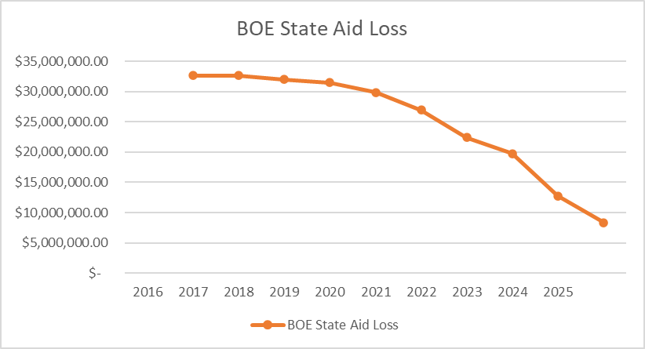
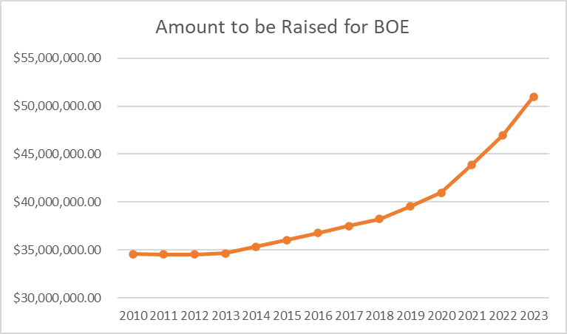
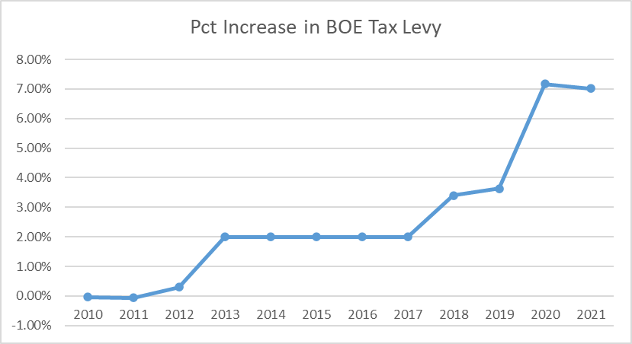
Board of education impacts

Slide 9
2024 Budget Goals
Responsible fiscal management – manage spending, strategically utilize surplus to continue essential services, to offset capital debt repayement, and to maintain a stable tax rate
Continue to aggressively look for new recurring revenue streams to reduce burden on the property taxpayer
Prioritize opportunities to increase & diversify tax base through redevelopment and new construction
Prioritize economic recovery, infrastructure, and public amenities such as roads, parks, recreation, and the arts, and identify creative sources of funding
Prioritize retaining employees and recruiting qualified staffing and professionals.

Slide 10
2024 Budget Accomplishments
Tax Rate Decrease: 11.76%
Projected Tax Rate: 0.517 as compared to 0586 in 2023
(reduction of 6.9 cents per $100 of value)
No loss of services
Continued growth of key programs – recreation / public safety / public works
Investment of cannabis funds in parks and public safety

Slide 11
Well Managed Debt Service Provides Capital Flexibility
Continuing with Ambitious 2024 Capital Plan
Planned Capital Projects—enabled by sound planning:
Continued significant road paving scheduled in partnership with utility companies, to share costs.
Drainage improvements
Recreation/Park improvements
Public Safety improvements & equipment
Technology enhancements
Improvements to lakes
Environmentally friendly flood reduction projects

Slide 12
2023 Tax apportionment

Slide 13
Sources of revenue to support budget

Slide 14
2024 General Budget Appropriations
 |  |  |  | Pct | Total Budgeted | Per Avg House
General Government |  |  |  | 7.54% | $4,168,000.00 | $222.17
Land Use / Code Enforcement |  |  |  | 2.61% | $1,443,100.00 | $76.92
Insurance |  |  |  | 13.79% | $7,618,860.00 | $406.11
Police / Public Safety |  |  |  | 25.28% | $13,968,095.09 | $744.54
Capital Improvement Fund |  |  |  | 0.91% | $500,000.00 | $26.65
Road Maintenance / Public Works |  |  |  | 11.95% | $6,603,259.33 | $351.97
Recreation / Education / Health |  |  |  | 3.98% | $2,196,078.44 | $117.06
Library |  |  |  | 3.71% | $2,050,413.00 | $109.29
Utilities and Bulk Expenses |  |  |  | 3.04% | $1,680,000.00 | $89.55
Deferred and Statutory Charges |  |  |  | 9.68% | $5,346,785.00 | $285.00
Shared Services |  |  |  | 2.08% | $1,148,091.00 | $61.20
Debt Service |  |  |  | 10.79% | $5,960,000.00 | $317.68
Reserve for Uncollected |  |  |  | 4.62% | $2,550,000.00 | $135.92
Contingent |  |  |  | 0.02% | $10,000.00 | $0.53
TOTAL APPROPRIATIONS – INCLUDING LIBRARY: $55,242,681.86

Slide 15
Breakdown of budget areas

Slide 16
Underpayment of State Aid to Neptune by Year (Totals more the $78,700,227.00 since 2001 & $5,807,839.00 for 2024 Alone)

Slide 17
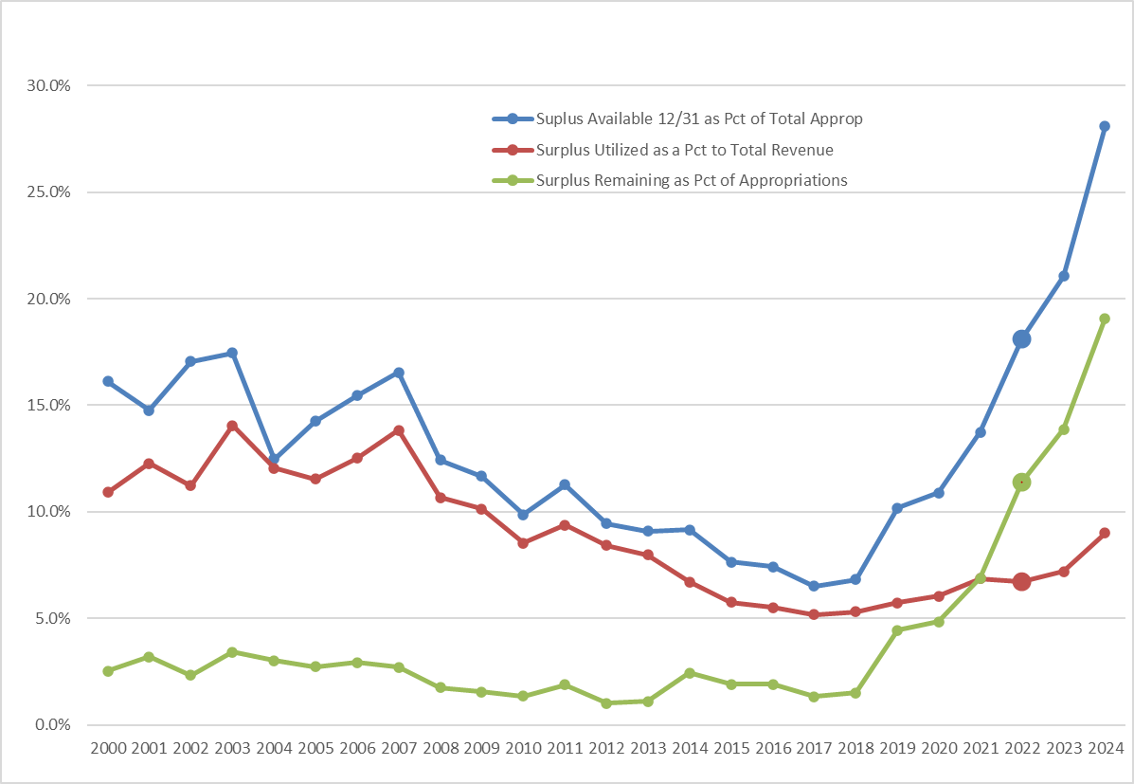

Slide 19
Ten Largest Taxpayers - 2023
No. | 2023 Owner of Record | Aggregate Assessed Value | % of Assessed Value (Real Property) | 2023 Net Tax | Common Name
1 | NEPTUNE PARTNERS LLC % BNE REAL EST | $40,503,400 | 0.7116% | $731,491.40 | Waverly Apartments
2 | DOWNING JB TIC I,II,III,IV LLC | $27,544,500 | 0.4839% | $497,453.67 | Jumping Brook Apartments
3 | ASPEN3600 LLC | $26,390,800 | 0.4637% | $476,617.85 | AIG Building
4 | NEPTUNE PLAZA SHOPPING CENTER, LLC | $24,356,900 | 0.4279% | $439,885.61 | Shop Rite
5 | WOODLANDS NEPTUNE LLC | $23,215,000 | 0.4079% | $419,262.90 | The Pointe Apartments
6 | WAL-MART REAL ESTATE BUSINESS TRUST | $20,809,600 | 0.3656% | $375,821.38 | Wal-Mart
7 | HD DEV. OF MARYLAND,INC.%PROP TAX | $15,215,500 | 0.2673% | $274,791.93 | Home Deport
8 | OCEAN GROVE CAMP MEETING ASSN | $15,088,400 | 0.2651% | $267,668.22 | Ocean Grove Camp Meeting
9 | MERIDIAN HOSPITALS CORP | $13,606,500 | 0.2391% | $245,733.39 | Jersey Shore University Medical Center
10 | OFW, LLC | $12,641,800 | 0.2221% | $228,310.91 | Lowy's

Slide 21
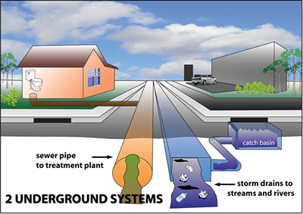
Sewer utility (sanitary)
Sewer utility is self-liquidating.
Sewer is regenerating surplus.
Major Sewer infrastructure projects will continue in efforts to reduce Infiltration & Inflow and prevent pollution of our waterways.
Sewer treatment costs remain stable due to reduced flow, benefiting Neptune and the Sewer Authority
Maintaining strong surplus position to prepare for long term infrastructure improvements.

Slide 22
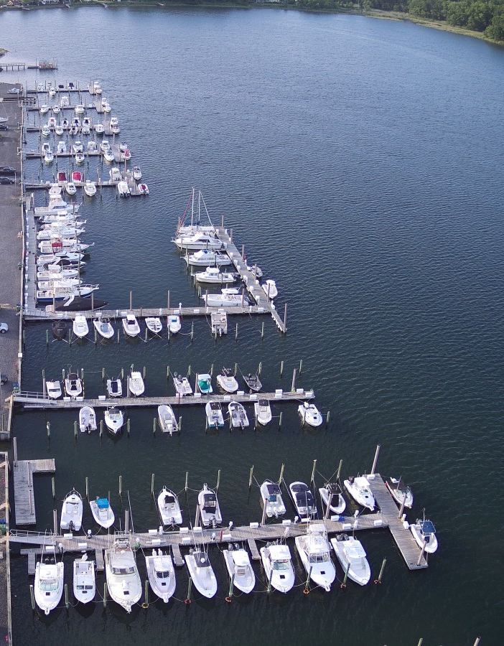
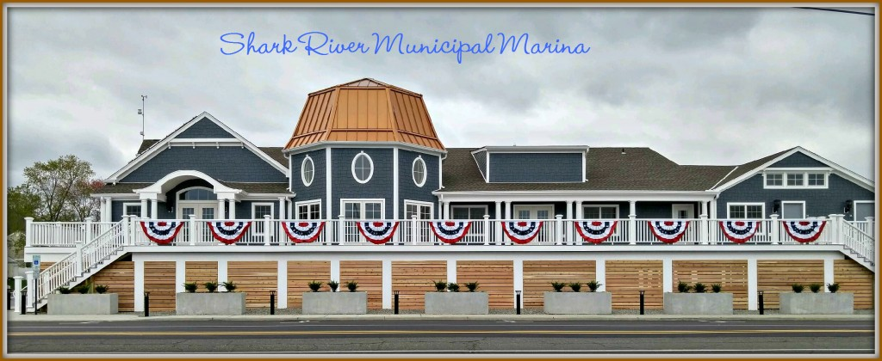
marina utility
Marina utility is self-liquidating.
Marina is regenerating surplus.
2023 investments in dock enhancements and basin dredging.
Marina rates remain stable due to increased revenue from dockage, winter storage, and kayak storage (marina user fees).
Additional revenue is expected from increased storage capacity and sold-out dock space.

Slide 23
2024 Budget Opportunities
New revenues and controlled spending should result in maintaining a level of surplus that assures that the Township remains prepared for emergencies and economic downturns without the typically associated tax spikes.
Expected growth through new construction and redevelopment should increase overall taxable valuation, allowing for continued tax rate stability and reductions.

Slide 24
Summary
2024 will remain fiscally challenging, but we are in a good financial position and will continue with the projects and initiatives the community wants and needs while maintaining our fiscal strength.
The last few years have revealed our significant risk of our over-reliance on residential property taxes, limited discretionary funding sources, and certain local revenues. Expansion of our revenue sources and focusing on commercial development and redevelopment should remain a focus of the governing body and the administration.

Slide 25
PUBLIC COMMENT / QUESTiONS

